Slide 1
Task 3
BVH:
Add functions
Like partition and sort
^ will go into scotty3d docs ~daniel
Add pseudo code based on Mia’s approach

Slide 2
Task 5
Do the derivation for refraction with syntax in programming HW

Slide 3
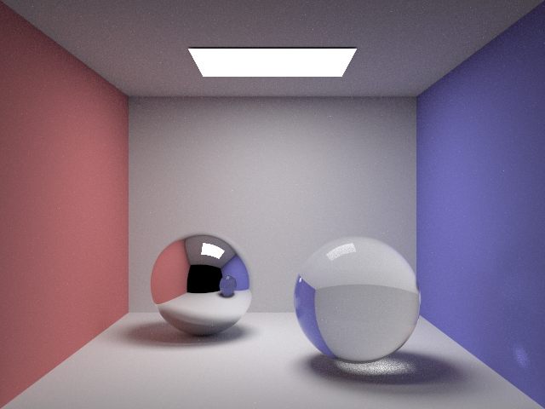
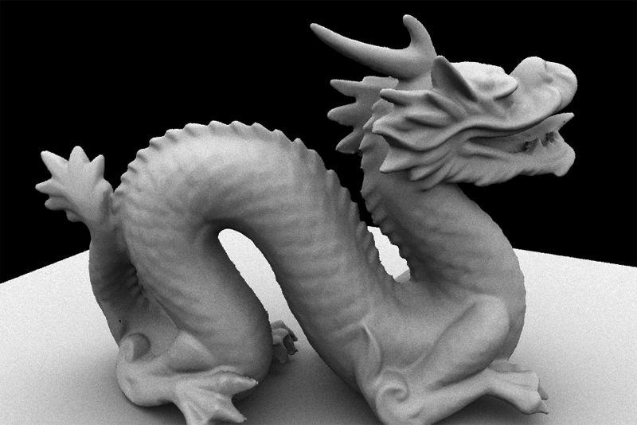
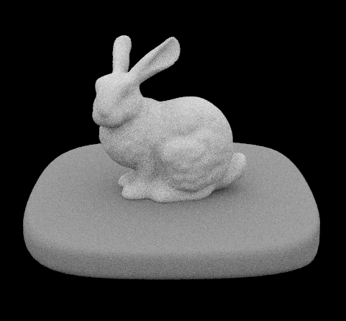
PathTracer
Finally you can put this on your resume

Slide 4
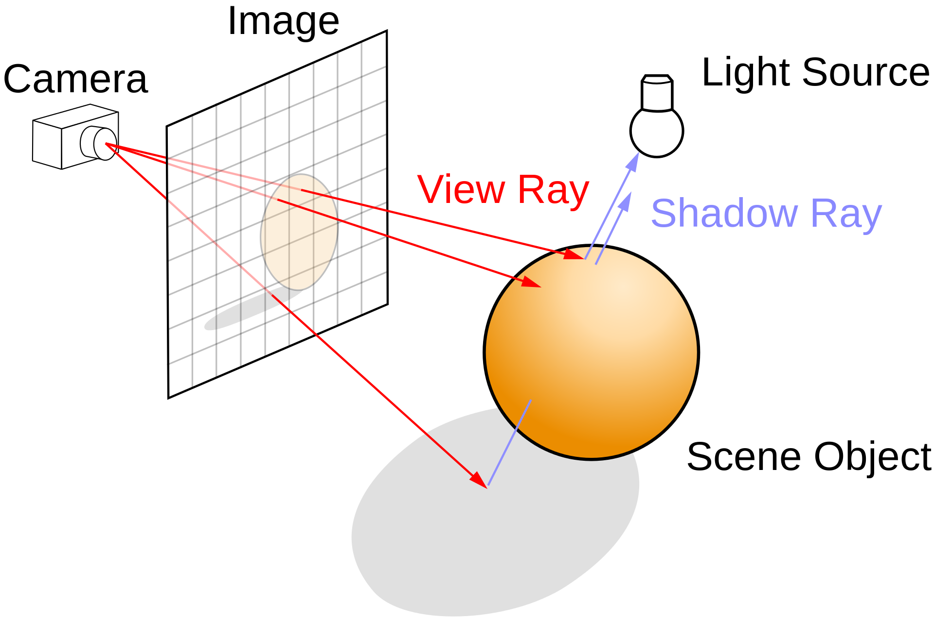
Goal of PathTracer Lab:
Implement an end-to-end path tracer pipeline!
https://en.wikipedia.org/wiki/Ray_tracing_(graphics)

Slide 5
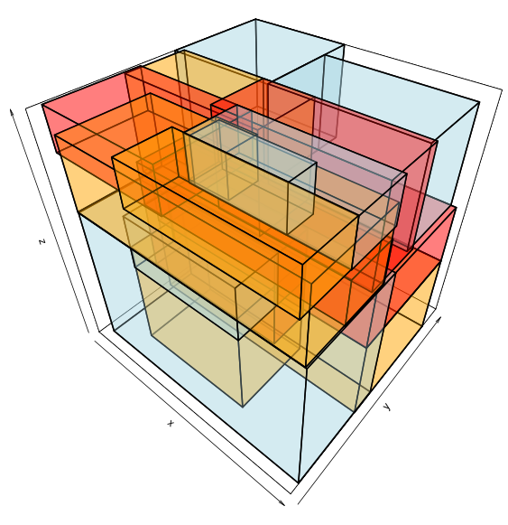
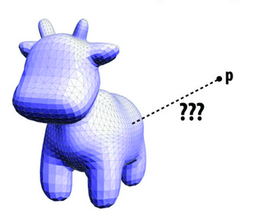
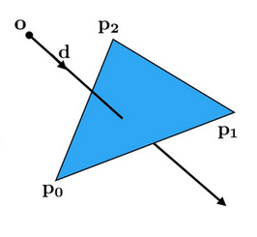
Overview of Tasks (Part I)
Task 1: Camera Rays
Scene
Task 3*: BVH
Task 2: Intersecting Primitives
https://github.com/davidmoten/rtree-multi

Slide 6
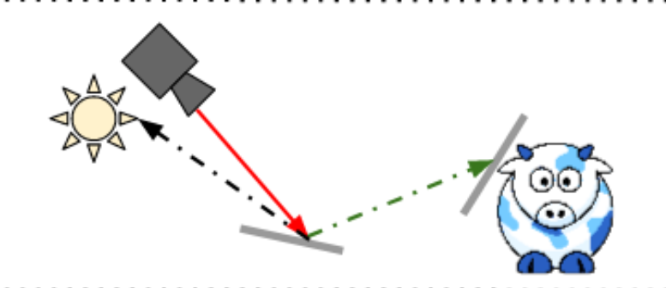
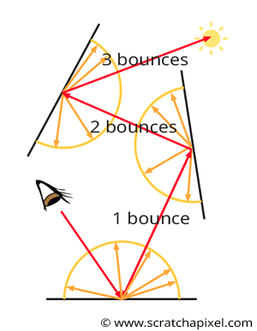
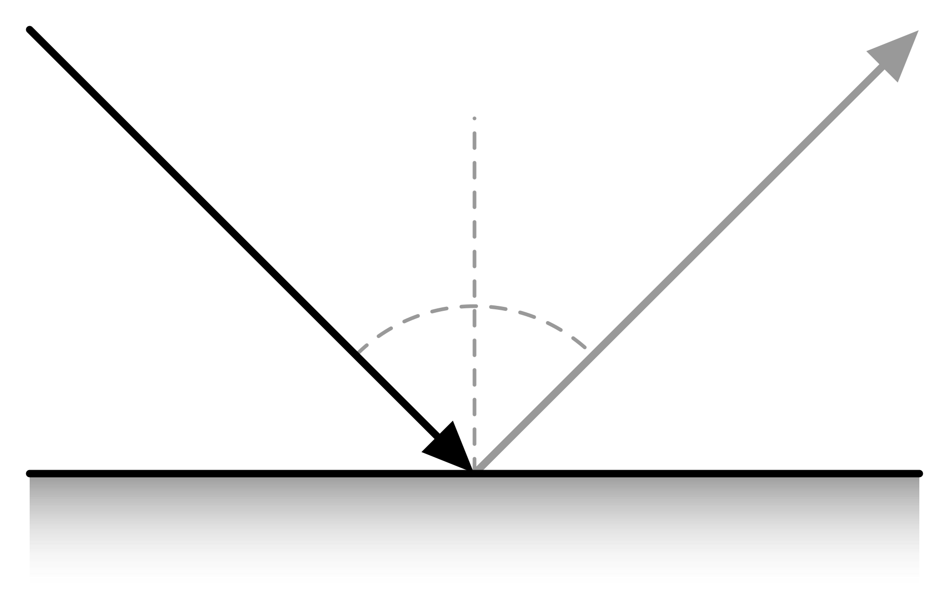
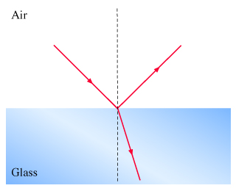
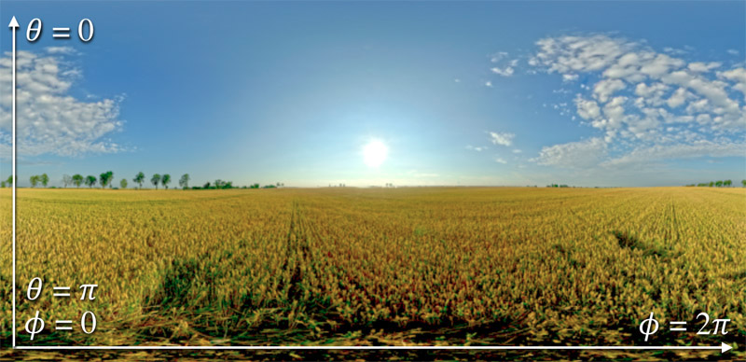
Overview of Tasks (Part II)
Task 6: Direct Lighting
Task 4: Path Tracing
Task 5: Materials
Task 7: Environment Light
https://en.wikipedia.org/wiki/Bidirectional_reflectance_distribution_function

Slide 7
Part I

Slide 8
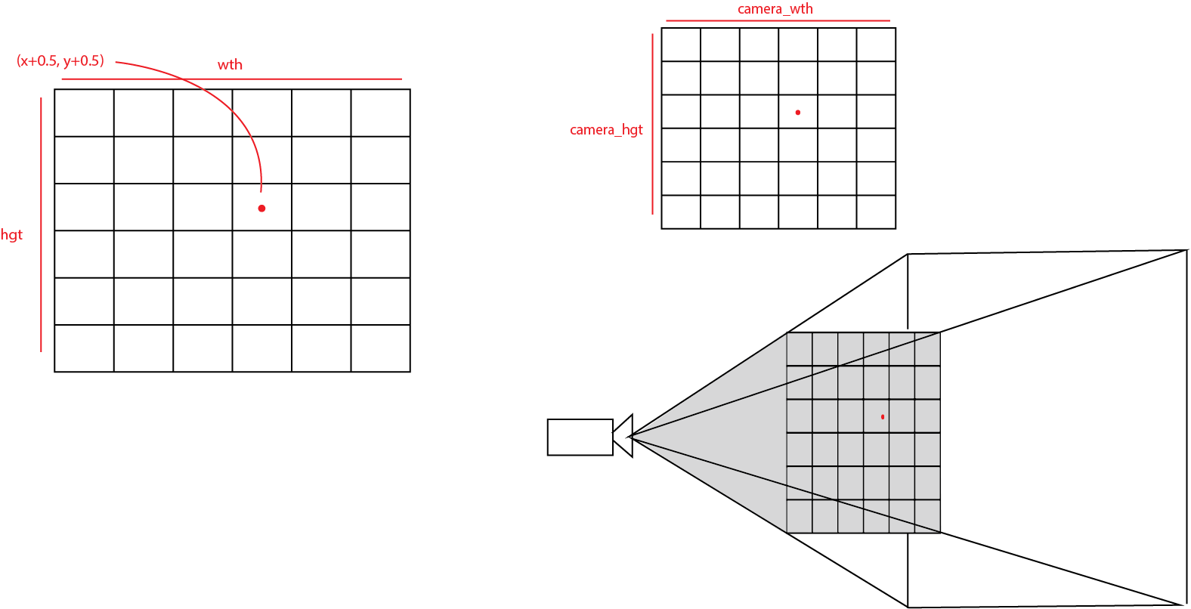
Task 1: Camera Rays
Pathtracer::trace_pixel
Normalize x, y coordinates (using half-int coordinates).
Pass resulting coordinates to generate_r ay().
generate_ray() will return a Ray object that you can use to get a color by calling trace()

Slide 9
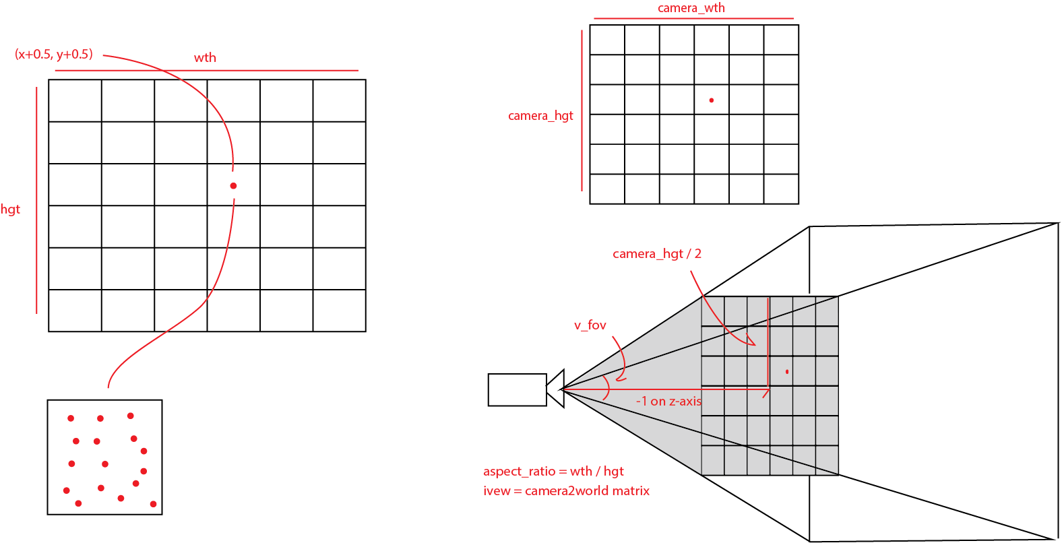
Task 1: Camera Rays
Camera::generate_ray
We’ve given you v_fov, the aspect_ratio, and z = -1. How do we get camera_hgt? camera_wth?
Answer: trig!
Convert camera coordinates to world coordinates to get the ray direction. What’s the ray origin?
Pathtracer::trace_pixel
Implement uniform sampler to generate one sample for each time trace_pixel is run (to support supersampling)

Slide 10
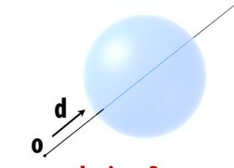
Task 2: Intersecting Primitives
Step 1: Intersecting Triangles
Step 2: Intersecting Spheres

Slide 11
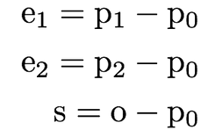
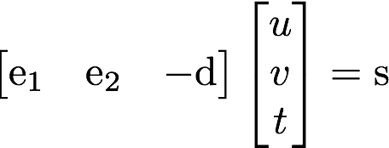
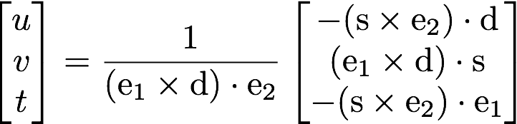
Task 2: Intersecting Primitives
Möller-Trumbore algorithm
A fast ray triangle intersection algorithm
Takes advantage of barycentric coordinates parametrization of the intersection point P
Step 1: Intersecting Triangles
System to solve:
Barycentric coordinates of hit point
e₂
s
Solve using Cramer’s Rule
e₁
Trace Triangle::hit(const Ray &ray);
in tri_mesh.cpp
Motivation is on Scotty3D

Slide 12
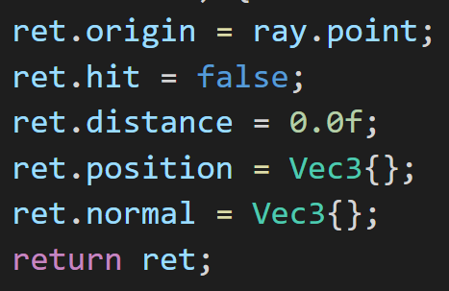
Task 2: Intersecting Primitives
Step 1: Intersecting Triangles
Inside Outside Triangle Test using Barycentric coordinates (ret.hit = True/False)
Populate ret.hit, ret.distance
Respect ray.dist_bounds
Fill in ret.position
ray.at(t) may be helpful
Fill in ret.normal
Use Barycentric coordinates to interpolate the normal at intersection point
Tri_Mesh_Vert.normal
e₂
s
e₁
Trace Triangle::hit(const Ray &ray);
in tri_mesh.cpp

Slide 13
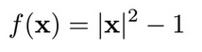
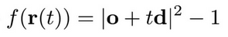
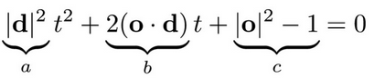
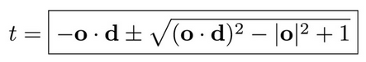
Task 2: Intersecting Primitives
Step 2: Intersecting Spheres
3D Point Vector [x,y,z]
Equation for unit sphere
Substitute ray vector
Rearrange equation, set f(x) = 0
Two solutions: one going in, one going out
Trace Sphere::hit(const Ray &ray);
in shapes.cpp

Slide 14
Task 2: Intersecting Primitives
Step 2: Intersecting Spheres
Solve Quadratic to get t (ret.hit = True/False)
Populate ret.hit and ret.distance
Respect ray.dist_bounds
Warning: what if ray.dir is not unit length?
Fill in ret.position
ray.at(t) may be helpful
Fill in ret.normal
Note: You can assume a sphere is centered at the origin because we are in local space
Trace Sphere::hit(const Ray &ray);
in shapes.cpp

Slide 15
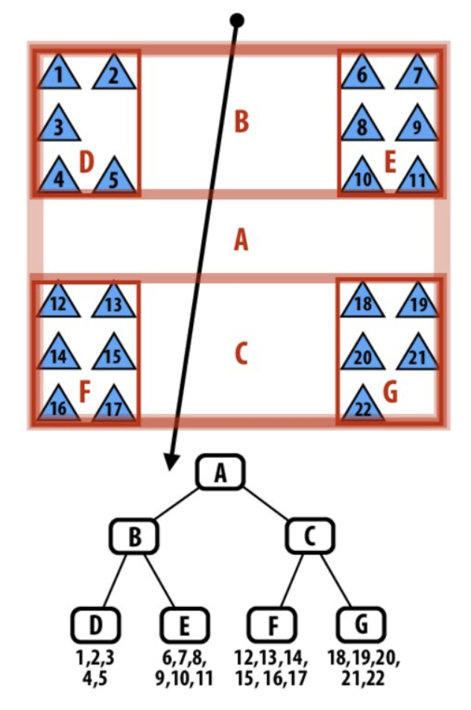
Task 3*: BVH
Bounding Volume Hierarchy
Spatial Hierarchy
B(ounding) Boxes + Primitives
Functions like a tree
Motivation:
Checking all the primitives at once per ray hit is expensive (O(n)), we want to speed it up. BVH’s tree structure makes it O(nlogn)

Slide 16
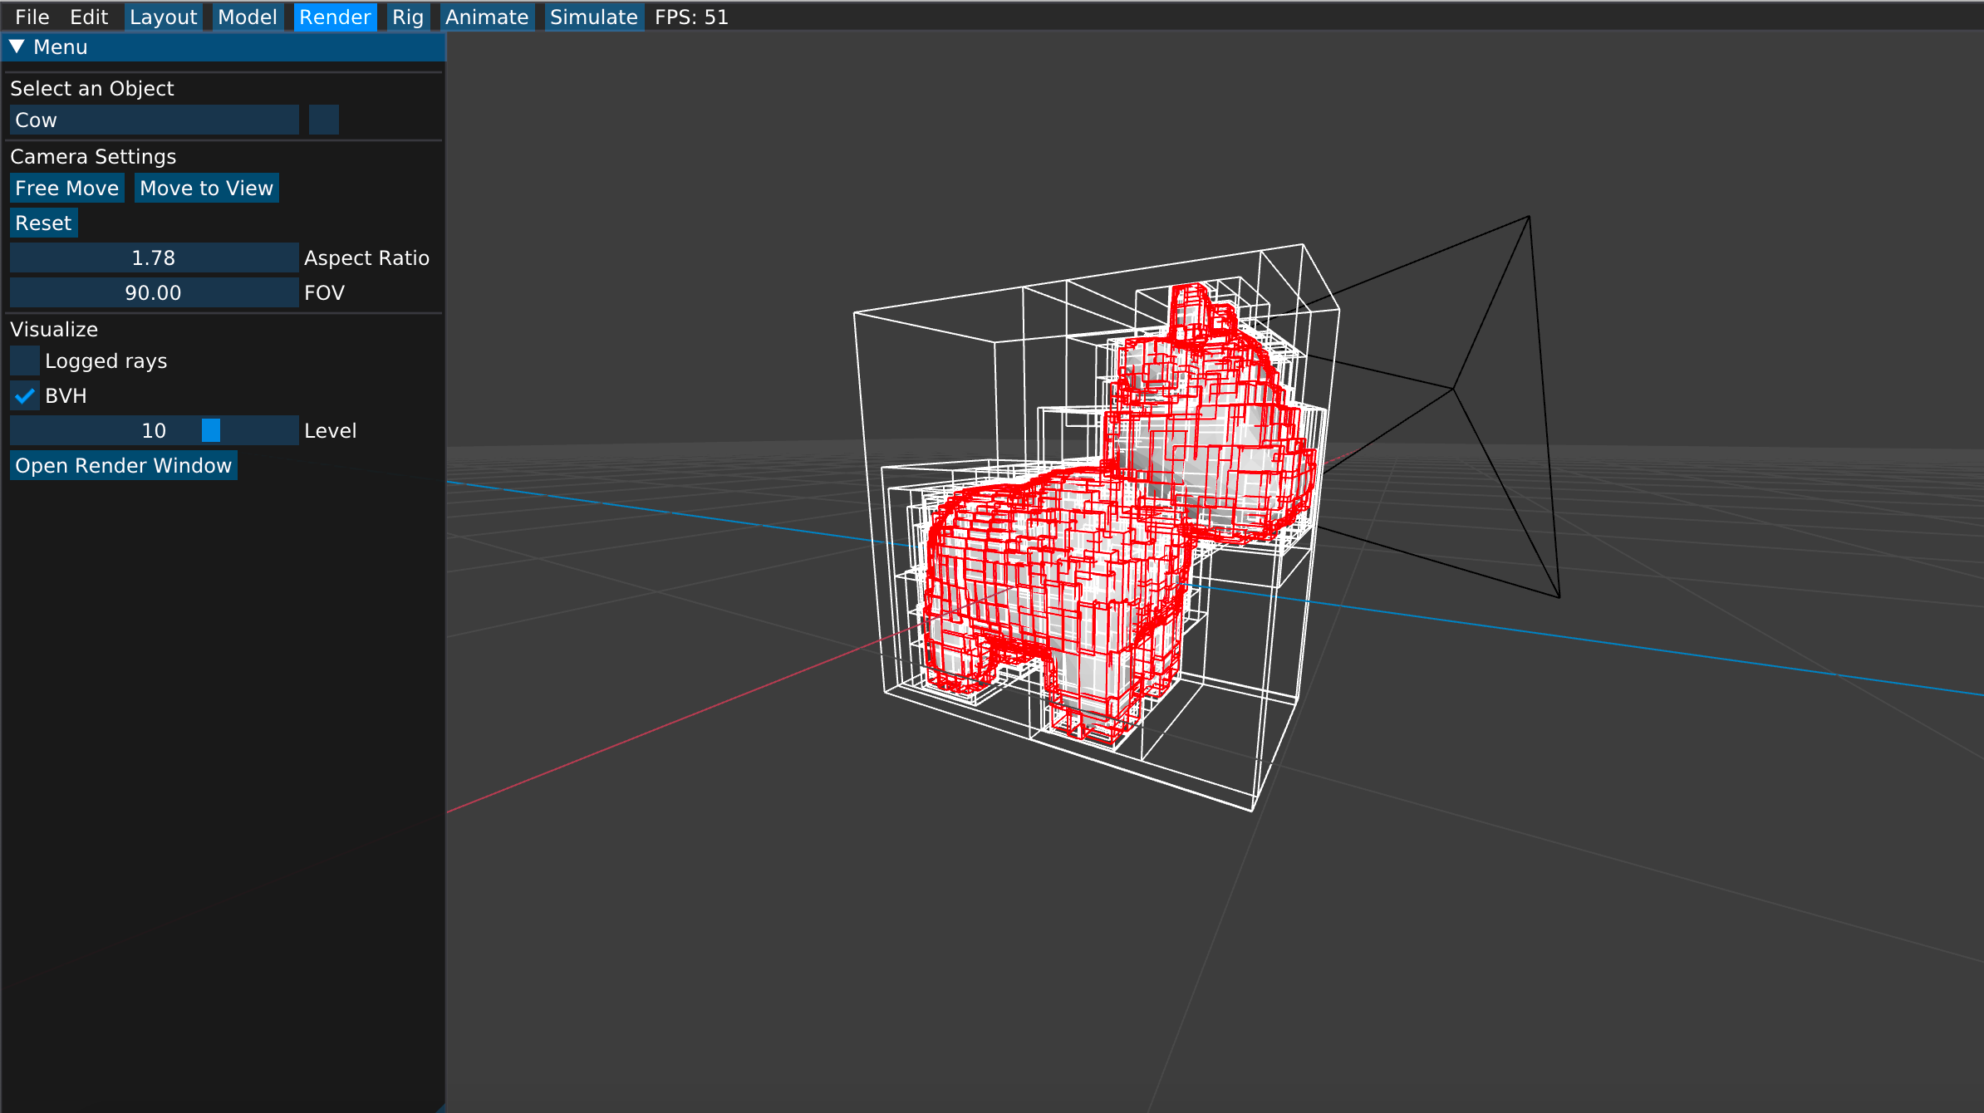
Task 3*: BVH
Step 0
High-Level Procedure:
Step 0 - Implement BBox Intersection
Step 1 - Create BVH acceleration data structure using Surface Area Heuristic (to make Step 2 faster)
Step 2 - Implement Ray Tracing with BVH data structure
Step 1
Step 2

Slide 17
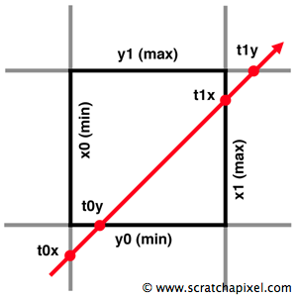
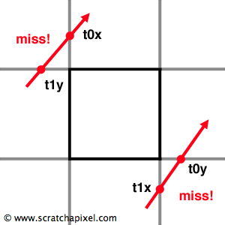
Task 3*: BVH
bool BBox::hit(const Ray &ray, Vec2 &times);
Step 0: Ray-BBox Intersection
Implement Ray-BBox intersection in BBox::hit
https://www.scratchapixel.com/lessons/3d-basic-rendering/minimal-ray-tracer-rendering-simple-shapes/ray-box-intersection

Slide 18
Task 3*: BVH
How do I partition the 3D space (and the mesh)?

Slide 19
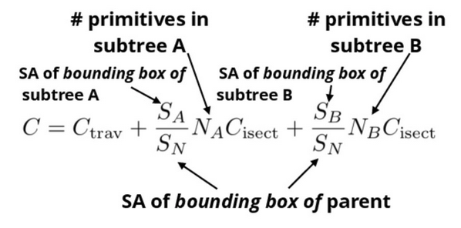
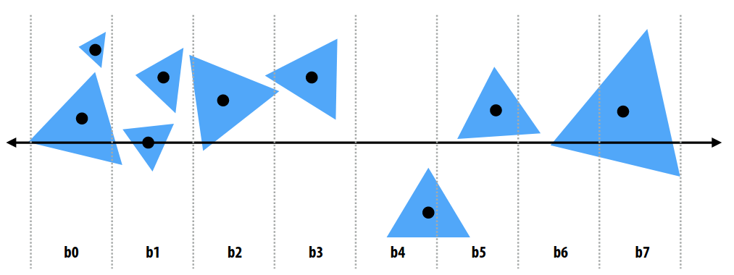
Task 3*: BVH
Step 1: BVH Construction
Surface Area Heuristic
Want to optimally sort Primitives into buckets (formed by partitions)
Bucket A
Bucket B

Slide 20
Task 3*: BVH
Step 1: BVH Construction
Surface Area Heuristic
Want to optimally sort Primitives into buckets (formed by partitions)
Bucket A
Bucket B
We can assume C_{trav} and C_{isect} to be 1 since they are constants (value itself is irrelevant)
So really, just the SAH :)
Notes:
Cost of traversing interior nodes, and cost of calculating intersection

Slide 21
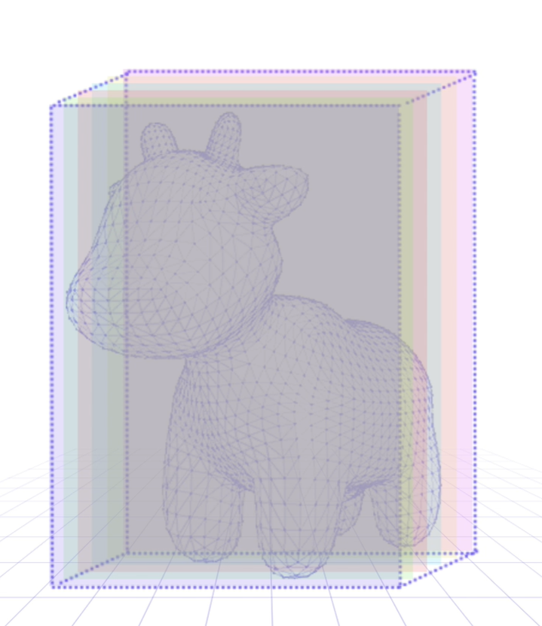
Task 3*: BVH
High Level Idea:
For each partition along the XYZ axis:
Define buckets along the line of partition
Calculate the BBox for the bucket based on the primitives in the bucket
Keep track of the best optimal partition
Construct the BVH based on the lowest cost partition found, and recurse on it(or make node leaf)

Slide 22
Task 3*: BVH
Step 1: BVH Construction
For axis x,y,z:
Initialize buckets
For each primitive p in node:
B = compute_bucket(p.centroid)
B.bbox.enclose(p.bbox)
B.prim_count++
For each of |B| - 1 possible partitions
Evaluate cost (SAH), keep track of lowest cost partition
Recurse on lowest cost partition found (or make node leaf)

Slide 23
Task 3*: BVH
Step 1: BVH Construction
Bucket = result from a possible (but maybe not the best) partition
In code: some variable that you will have to keep track of
Partition along x = 1, 2, 3 …
Bucket 1
Bucket 2
For axis x,y,z:
Initialize buckets
For each primitive p in node:
B = compute_bucket(p.centroid)
B.bbox.enclose(p.bbox)
B.prim_count++
For each of |B| - 1 possible partitions
Evaluate cost (SAH), keep track of lowest cost partition
Recurse on lowest cost partition found (or make node leaf)

Slide 24
Task 3*: BVH
Step 1: BVH Construction
Bucket = result from a possible (but maybe not the best) partition
In code: some variable that you will have to keep track of
Partition along x = 1, 2, 3 …
Bucket 1
Bucket 2
For axis x,y,z:
Initialize buckets
For each primitive p in node:
B = compute_bucket(p.centroid)
B.bbox.enclose(p.bbox)
B.prim_count++
For each of |B| - 1 possible partitions
Evaluate cost (SAH), keep track of lowest cost partition
Recurse on lowest cost partition found (or make node leaf)

Slide 25
Task 3*: BVH
Big box
Step 1: BVH Construction
Bucket 1
Bucket 2
<< nodes
Bucket 1
Bucket 2
For axis x,y,z:
Initialize buckets
For each primitive p in node:
B = compute_bucket(p.centroid)
B.bbox.enclose(p.bbox)
B.prim_count++
For each of |B| - 1 possible partitions
Evaluate cost (SAH), keep track of lowest cost partition
Recurse on lowest cost partition found (or make node leaf)

Slide 26
Task 3*: BVH
Step 1: BVH Construction
Bucket 1 Count: 1
Bucket 2 Count: 0
Bucket 1
Bucket 2
For axis x,y,z:
Initialize buckets
For each primitive p in node:
B = compute_bucket(p.centroid)
B.bbox.enclose(p.bbox)
B.prim_count++
For each of |B| - 1 possible partitions
Evaluate cost (SAH), keep track of lowest cost partition
Recurse on lowest cost partition found (or make node leaf)

Slide 27
Task 3*: BVH
Partition 1
Step 1: BVH Construction
Bucket 1 Count: 2
Bucket 2 Count: 0
Bucket 1
Bucket 2
For axis x,y,z:
Initialize buckets
For each primitive p in node:
B = compute_bucket(p.centroid)
B.bbox.enclose(p.bbox)
B.prim_count++
For each of |B| - 1 possible partitions
Evaluate cost (SAH), keep track of lowest cost partition
Recurse on lowest cost partition found (or make node leaf)

Slide 28
Task 3*: BVH
Partition 1
Partition 2
Step 1: BVH Construction
Bucket 1 Count: 1
Bucket 2 Count: 1
Bucket 1 Count: 2
Bucket 2 Count: 0
Bucket 1
Bucket 2
For axis x,y,z:
Initialize buckets
For each primitive p in node:
B = compute_bucket(p.centroid)
B.bbox.enclose(p.bbox)
B.prim_count++
For each of |B| - 1 possible partitions
Evaluate cost (SAH), keep track of lowest cost partition
Recurse on lowest cost partition found (or make node leaf)

Slide 29
Task 3*: BVH
Partition 1
Partition 2
Step 1: BVH Construction
Bucket 1 Count: 1
Bucket 2 Count: 1 SAH = big
Bucket 1 Count: 2
Bucket 2 Count: 0 SAH = small
Bucket 1
Bucket 2
For axis x,y,z:
Initialize buckets
For each primitive p in node:
B = compute_bucket(p.centroid)
B.bbox.enclose(p.bbox)
B.prim_count++
For each of |B| - 1 possible partitions
Evaluate cost (SAH), keep track of lowest cost partition
Recurse on lowest cost partition found (or make node leaf)

Slide 30
Task 3*: BVH
Step 1: BVH Construction
For axis x,y,z:
Initialize buckets
For each primitive p in node:
B = compute_bucket(p.centroid)
B.bbox.enclose(p.bbox)
B.prim_count++
For each of |B| - 1 possible partitions
Evaluate cost (SAH), keep track of lowest cost partition
Recurse on lowest cost partition found (or make node leaf)
Bucket 1
Bucket 2
(stop if number of primitives <= max_leaf_size)

Slide 31
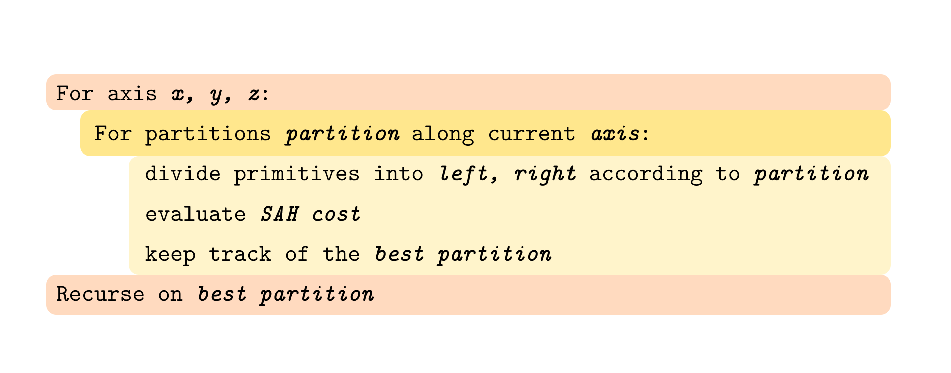
Another way to think about it

Slide 32
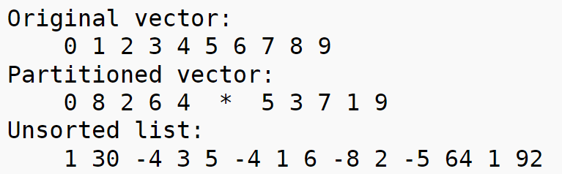
Helpful functions!
Std::partition
Note that the elements are not sorted within the subgroups themselves. You may want to use std::sort to sort them.
* is where auto it is at

Slide 33
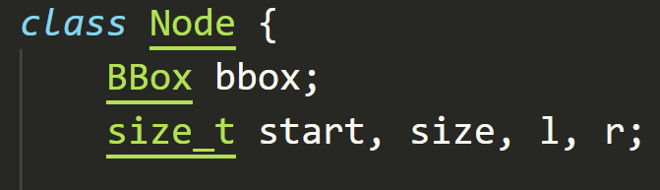
Helpful functions!
Bbox.enclose - lets one box enclose another
Bbox.center - center of the box
primitives(in build) - vector/array of primitives
Node - used to construct the tree

Slide 34
Task 3*: BVH

Slide 35
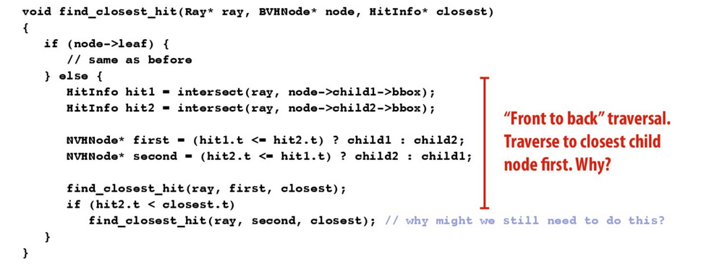
Task 3*: BVH
Step 2: Ray-BVH Intersection
Trace BVH<Primitive>::hit(const Ray& ray);
HitInfo* hitsecond = hit1.t <= hit2.t ? &hit2 : &hit1;
find_closest_hit(ray, first, closest);
if(hitsecond->t < closest->t)
find_closest_hit(ray, second, closest);

Slide 36
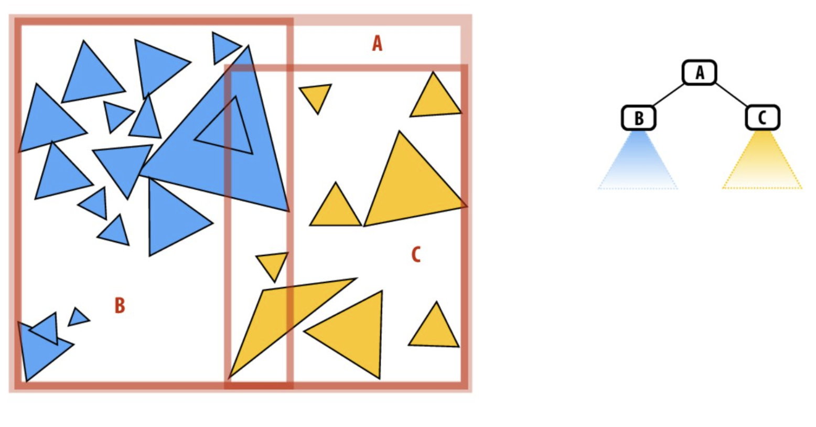
OK

Slide 37
NOT OK

Slide 38
Part II

Slide 39
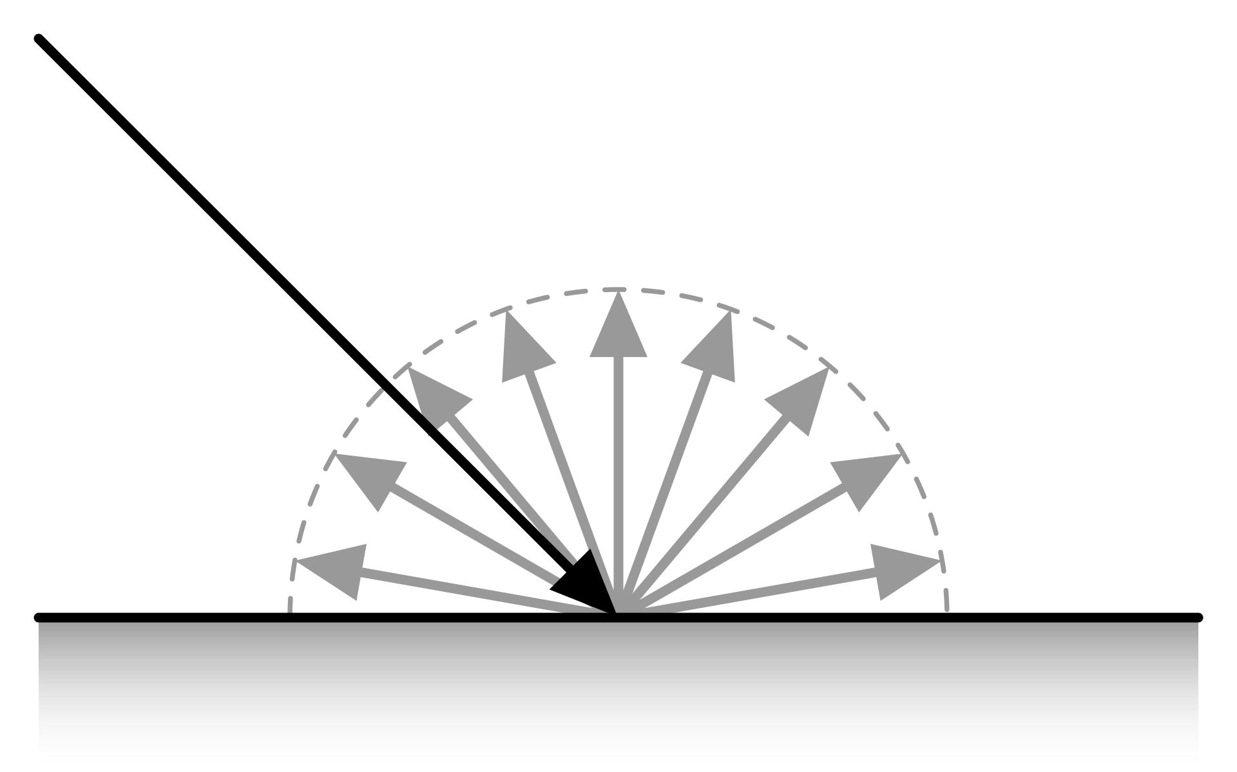
Task 4: Path Tracing
BSDF_Lambertian
::scatter - returns a Scatter object containing direction and attenuation components of the new ray / surface color
::evaluate - computes the ratio of incoming to outgoing radiance given a pair of directions
::pdf - returns the pdf of a Cosine-weighted sampler

Slide 40
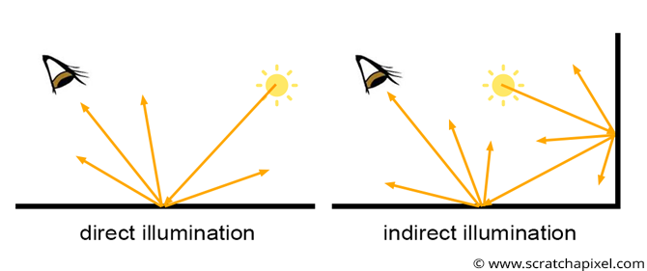
Task 4: Path Tracing
Direct & Indirect Lighting
Randomly sample a new ray direction from the BSDF distribution using BSDF::scatter().
Create a new world-space ray and call Pathtracer::trace() to get incoming light. You should modify dist_bounds so that the ray does not intersect at time = 0. Remember to set the new depth value.
Compute Monte Carlo estimate of incoming light scaled by BSDF attenuation. Use is_discrete() to determine if need to scale by pdf.

Slide 41
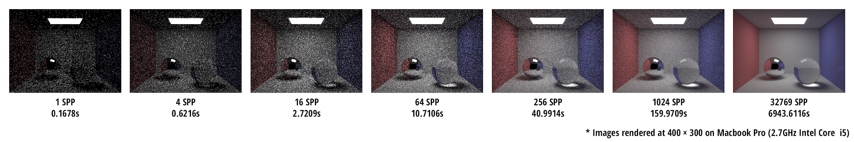
Task 4: Path Tracing
Calculating direct and indirect lighting with Monte Carlo
Idea:

Slide 42

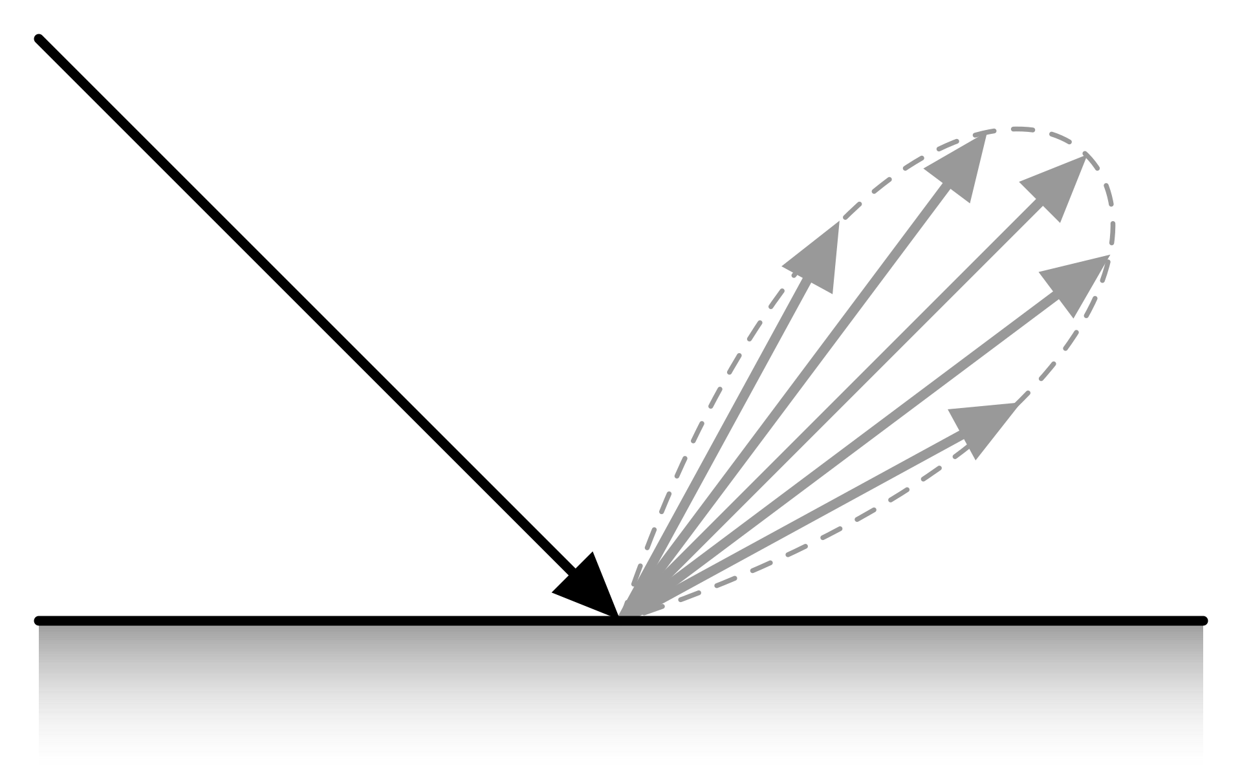
Task 4: Path Tracing
Spectrum Pathtracer::trace_ray(const Ray& ray)
// direct_light calculated from // Task 4/Reference code
// calculate indirect lighting
if random number > terminate probability:
return direct_light
else:
// create next ray based on BSDF sample
// return next ray contribution and recurse to get ray after next ray
return direct_light +
sample.attenuation * scale * trace_ray(next_ray)

Slide 43
Task 5: Materials
Step 0: Lambertian BSDF
Step 1: Mirror BSDF
Step 2: Glass BSDF

Slide 44
Quick Overview of the code you will implement
Scatter scatter(Vec3 out_dir): given out_dir, generates a random sample for in_dir. It returns a Scatter, which contains both the sampled direction and the attenuation for the in/out pair.
Remember that we are tracing rays backwards, from the camera into the scene. This the reason why the input to your scatter functions is the out_dir, you are calculating the in_dir.

Slide 45
Quick Overview of the code you will implement
Scatter scatter(Vec3 out_dir): given out_dir, generates a random sample for in_dir. It returns a Scatter, which contains both the sampled direction and the attenuation for the in/out pair.
You will implement these two helper functions:
Vec3 reflect(Vec3 dir): returns a direction that is the perfect specular reflection of dir about {0, 1, 0}(normal of surface).
Vec3 refract(Vec3 out_dir, float index_of_refraction, bool& was_internal): returns the ray that results from refracting out_dir through the surface according to Snell’s Law.

Slide 46
Quick Overview of the code you will implement
Scatter scatter(Vec3 out_dir): given out_dir, generates a random sample for in_dir. It returns a Scatter, which contains both the sampled direction and the attenuation for the in/out pair.
You will get this through:
Spectrum evaluate(Vec3 out_dir, Vec3 in_dir): evaluates the BSDF for a given pair of directions. This is only defined for continuous BSDFs.
In the starter code, only defined for Lambertian. You will calculate this value within your function scatter.
This is dependent on the surface property of the material (hint: look in the definition BSDF_glass and BSDF_mirror!)

Slide 47
Task 5: Materials
Step 1: Mirror BSDF
struct BSDF_Mirror {
BSDF_Sample sample(Vec3 out_dir) const;
Spectrum evaluate(Vec3 out_dir, Vec3 in_dir) const;
Spectrum reflectance;
}
struct Scatter{
Spectrum attenuation; // reflectance
Vec3 direction; // flip it! (in reflect)
}

Slide 48
Task 5: Materials
General Idea:
Based on the direction of the ray...
Try refraction
Determine if total internal reflection is happening
If yes, reflect(identical to mirror）
Calculate the Fresnel coefficient(Fr)
Reflect or refract probabilistically based on Fr
Reflect with the probability of Fr
Refract/Transmit with probability of (1-Fr)
Step 2: Glass BSDF

Slide 49
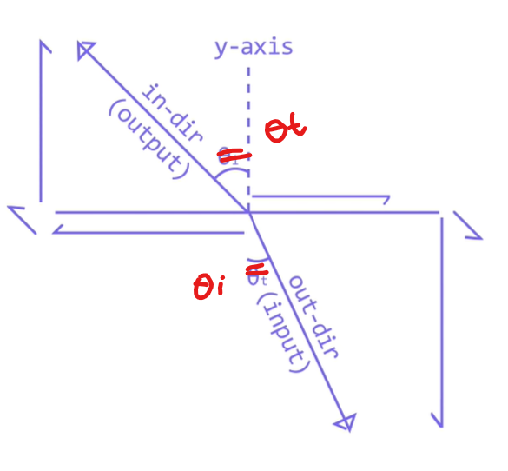
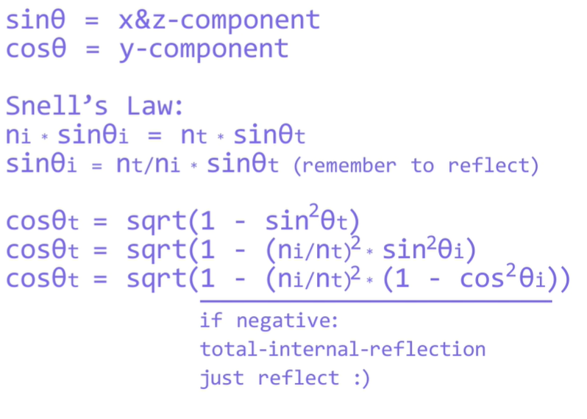
Refraction
Typo in the diagram making everything confusing ;-;
How to find x & z direction?

Slide 50
Refraction
Typo in the diagram making everything confusing ;-;
Want to find cos(theta)_t
The y-direction of the incoming ray
>> use trig properties!
How to find x & z direction?

Slide 51
Refraction
Typo in the diagram making everything confusing ;-;

Slide 52
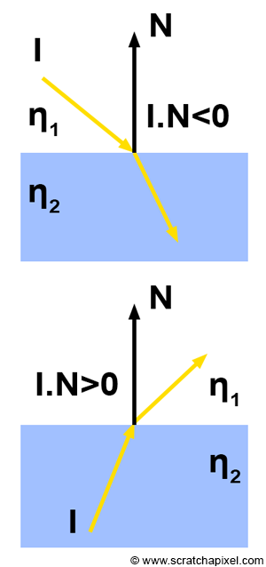
Refraction
ni
Your implementation should assume that when in_dir enters the surface (that is, if cos(theta_out) > 0) then the ray was previously travelling in a vacuum (i.e. index of refraction = 1.0). If cos(theta_out) < 0, then in_dir is leaving the surface and entering a vacuum.
nt
Cos(theta_out) < 0 then
ni = 1, nt = ior
Cos(theta_out) > 0 then
nt = ior, ni =1
nt
ni

Slide 53
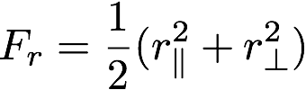
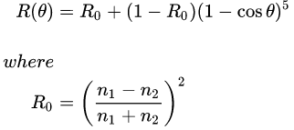
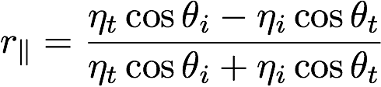
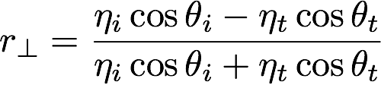
Task 5: Materials
Use Fresnel Equations to calculate the reflection Fresnel coefficient - the proportion of reflected to refracted light
Step 2: Glass BSDF
Schlick’s Approximation
F_{r} = proportion of reflected light
1 - F_{r} = proportion of refracted light
R(θ) = proportion of reflected light
1 - R(θ) = proportion of refracted light

Slide 54
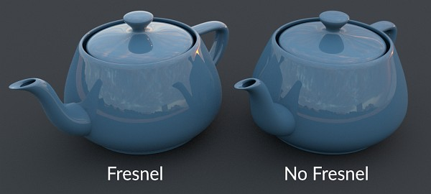
Fresnel
How much light they reflect vs the amount they transmit actually depends on the angle of incidence. The amount of transmitted light increases when the angle of incidence decreases.
source:Introduction to Shading (Reflection, Refraction and Fresnel) (scratchapixel.com)

Slide 55
Task 5: Materials
Don’t forget to account for Total Internal Reflection as Well!
Step 2: Glass BSDF
struct BSDF_Glass {
BSDF_Sample sample(Vec3 out_dir) const;
Spectrum evaluate(Vec3 out_dir, Vec3 in_dir) const;
Spectrum transmittance;
Spectrum reflectance;
float index_of_refraction;
}
struct BSDF_sample {
Spectrum attenuation; // scaled reflectance or // transmittance
Vec3 direction; // reflect(Vec3 dir) or
// refract(Vec3 dir)
}

Slide 56
Task 6: Direct Lighting++
If the BSDF is discrete, you can ignore the following steps.
Equally randomly choose to sample from BSDF::scatter or Pathtracer::sample_area_lights. Pay attention to inputs and outputs for both functions!
Recompute the new pdf value, given the additional choice of sampling from the area lights - use Pathtracer::area_lights_pdf. Watch the inputs/outputs!

Slide 57
Task 7: Environment Light
Implement the following functions:
In samplers.cpp
Vec3 Sphere::Uniform::sample() const; // Uniform sampler Sphere::Image::Image(const HDR_Image& image) const; //Set up importance sampling data structure Vec3 Sphere::Image::sample() const; //use the data to generate a sampling direction Float Sphere::Image::pdf(Vec3 dir) const; //calculate the pdf
In env_light.cpp
Vec3 Env_Map::sample() const //how to sample(uniform vs importance) float Env_Map::pdf(Vec3 dir) const //returns the pdf Spectrum Env_Map::evaluate(Vec3 dir) const // find incoming light along dir

Slide 58
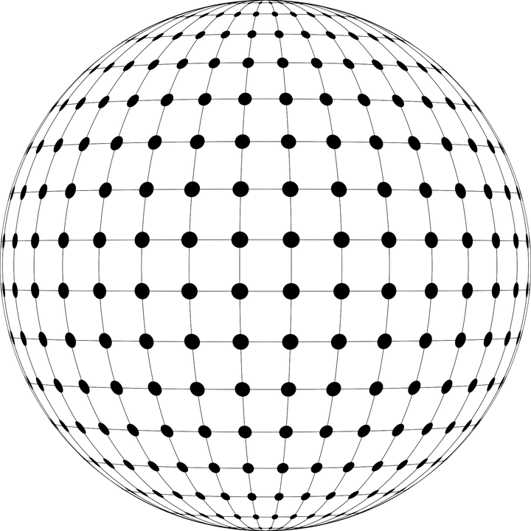
Task 7: Environment Light
Step 1: Uniform Sampling
Vec3 Sphere::Uniform::sample() const; // Uniform sampler Vec3 Env_Sphere::sample() const float Env_Sphere::pdf(Vec3 dir)
Hint #1: A sphere’s surface area is 4πr
Hint #2: Look at Hemisphere::Uniform::sample for generating vectors

Slide 59
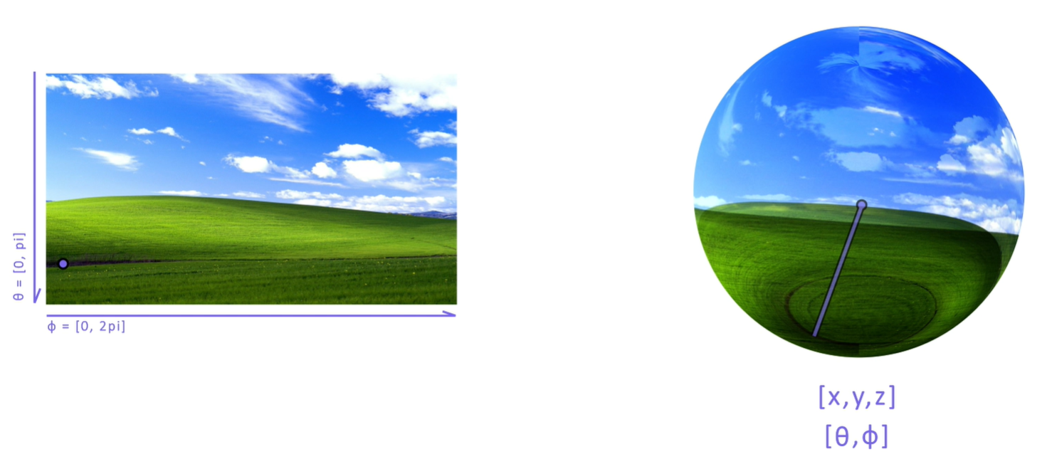
Task 7: Environment Light
Step 1: Uniform Sampling
Spectrum Env_Map::evaluate(Vec3 dir) const // find incoming light along dir
General Idea: 1. vector direction → spherical coordinates(theta & phi) → UV coordinates 2. Multiply by image dimensions to get actual pixel coordinates 3. Find 4 nearest pixels, perform bilinear interpolation
(Video explains it pretty well)

Slide 60
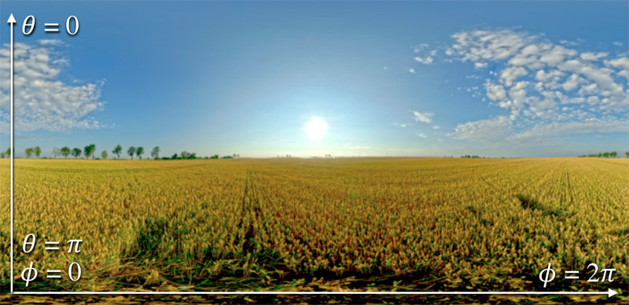
Task 7: Environment Light
Step 2: Importance Sampling
Sphere::Image::Image(const HDR_Image& image) const;
Populate the pdf and cdf vectors based on flux through each pixel
(flux through pixel is proportional to L sin(Θ) )
Vec3 Sphere::Image::sample() const; // Importance sampler
Generate a weighted random phi and theta coordinate pair, convert to xyz coordinates (Vec3)

Slide 61
Task 7: Environment Light(conceptual)
Image I have a 4 pixel image
If I do uniform sampling, what’s the probability density function(pdf) that I sample each pixel?
0.25 (¼) for all pixels, each pixel has a equal chance of being sampled.
0.2 | 0.6 | 1 | 0.2
lumen

Slide 62
Task 7: Environment Light(conceptual)
Image I have a 4 pixel image
If I do importance sampling(favoring brighter pixels), what’s the probability density function(pdf) that I sample each pixel?
**intuitively, we know brighter pixel should have a higher probability
0.2 | 0.6 | 1 | 0.2
lumen
X / 2
We take each pixel’s luminosity and divide it by the total luminous intensity of the image
0.1 | 0.3 | 0.5 | 0.1

Slide 63
Task 7: Environment Light(conceptual)
Image I have a 4 pixel image
Now, what if I calculate the Cumulative distribution function(CDF)?
(just add it together!)
0.2 | 0.6 | 1 | 0.2
lumen
0.1 | 0.3 | 0.5 | 0.1
pdf
0
0.5
1
0.1 | 0.4 | 0.9 | 1
0.1 | 0.4 | 0.9 | 1
cdf
cdf

Slide 64
Task 7: Environment Light(conceptual)
0
0.5
1
0.1 | 0.4 | 0.9 | 1
0.1 | 0.4 | 0.9 | 1
cdf
cdf
What happens now if I take a random sample between 0 - 1, and find which index contains that within my cdf?
You’re more likely to sample the points with higher luminosity! Which is what we want in importance sampling. From here you can find the index of the element you sampled, and retrieve its pdf & luminance values.

Slide 65


Make a pretty Image!

Slide 66


Make a pretty Image!

Slide 67
Make a pretty Image!

Slide 68
Ray Lifecycle
Intersect Scene
Triangles
Camera
BVH
Pathtracer
Spheres
Task 1: generate rays
Shadow rays
Environment Light
Miss
Hit
Environment Light
Recurse
Estimate
Lighting
New ray
BSDF

Slide 69
Ray Lifecycle
Task 2: intersect primitives
Intersect Scene
Triangles
Camera
BVH
Pathtracer
Spheres
Shadow rays
Environment Light
Miss
Hit
Environment Light
Recurse
Estimate
Lighting
New ray
BSDF

Slide 70
Ray Lifecycle
Task 3: build & intersect BVH
Intersect Scene
Triangles
Camera
BVH
Pathtracer
Spheres
Shadow rays
Environment Light
Miss
Hit
Environment Light
Recurse
Estimate
Lighting
New ray
BSDF

Slide 71
Ray Lifecycle
Intersect Scene
Triangles
Camera
BVH
Pathtracer
Spheres
Shadow rays
Task 4: cast shadow rays
Environment Light
Miss
Hit
Environment Light
Recurse
Estimate
Lighting
New ray
BSDF

Slide 72
Ray Lifecycle
Intersect Scene
Triangles
Camera
BVH
Pathtracer
Spheres
Shadow rays
Environment Light
Miss
Hit
Environment Light
Recurse
Estimate
Lighting
Task 5: path tracing
New ray
BSDF

Slide 73
Ray Lifecycle
Intersect Scene
Triangles
Camera
BVH
Pathtracer
Spheres
Shadow rays
Environment Light
Miss
Hit
Environment Light
Recurse
Estimate
Lighting
New ray
BSDF
Task 6: materials

Slide 74
Ray Lifecycle
Intersect Scene
Triangles
Camera
BVH
Pathtracer
Spheres
Shadow rays
Environment Light
Miss
Hit
Environment Light
Recurse
Estimate
Lighting
Task 7: environment lighting
BSDF
New ray

